Slide 1
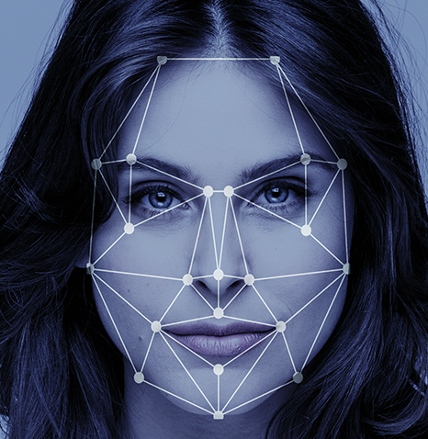
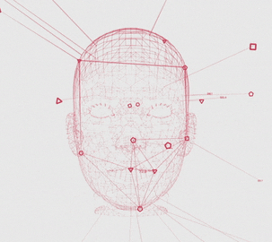
AI Based Facial Authentication & Attendance Marking System
A. Durga Prasad
K. Sanjay Kumar
k. Naveen
g. Nitish babu

Slide 2

Attendance Authentication System:
This facial biometric system takes a picture of a student using a camera and contrasts that image and compares the image with the stored records at the time of enrolment and if it matches, then it marks the attendance and monitors the student performance continuously

Slide 3
Role of AI:
Artificial intelligence monitor the student attendance like capturing the students pictures and compare those pictures with the class records to analyze the student data how much time the student presents in class.
Automatically the analyzed data is stored in a CSV file along with date & time.

Slide 4
Project Work Flow
Picture Input
Face Detection
Pre-Processing
Attendance Marking & Lock Opening
Take input from the Camera
Comparison of detected face with known faces
If the detected face with known faces then marking attendance for that student & Opening the Lock
Scaling down the image to 1/4th of its size and converting to RGB

Slide 5
Picture Input:
In this phase, camera starts rolling and gives input to the system.
Primarily the input is taken from the webcam provided in system. We can take input from any other external camera, by making some simple changes in code.
The live picture input is shown on the display for user interaction.

Slide 6
Pre-Processing:
In this step, we actually perform some pre-processing techniques for making image handy for our usage.
One of the technique we perform in Pre-Processing techniques is, we convert the original image into the Lower size image.
By reducing its size our computational speed can be improved and resources usage can be reduced.

Slide 7
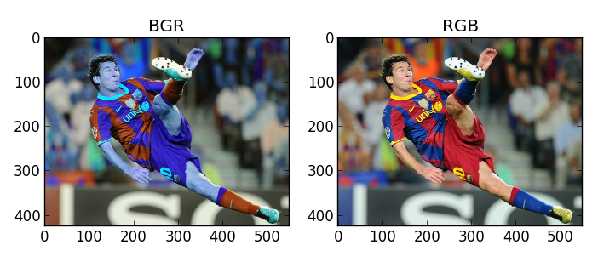
Other pre-processing technique is we get the BGR(Blue Green Red) image from camera.
Our face recognition module in python uses only RGB format.
So, the BGR image is converted into RGB image.

Slide 8
Face Detection:
After pre-processing, the system detects the faces in the input.
Then it compares the face with known faces which are already provided to system in a particular folder.
It uses the face characteristics like
Distance between nose and lips
Eyes colour and distance between eyes and nostrils.
Face shape and etc.
to determine the similarities between known faces and unknown face.

Slide 9
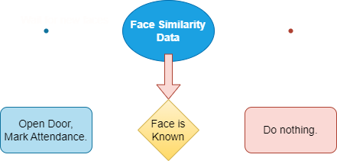
Attendance marking and Door Unlocking
After finding similarities of the input with known images, system will detect that the input face is known or unknown.
If the face is known then the attendance is marked and the door lock will be opened.
Else nothing will be happened and door stay closed.

Slide 10
Attendance marking and Door Unlocking
After finding similarities of the input with known images, system will detect that the input face is known or unknown.
If the face is known then the attendance is marked and the door lock will be opened.
Else nothing will be happened and door stay closed.

Slide 11
Attendance marking and Door Unlocking
After finding similarities of the input with known images, system will detect that the input face is known or unknown.
If the face is known then the attendance is marked and the door lock will be opened.
Else nothing will be happened and door stay closed.

Slide 12
Attendance marking and Door Unlocking
After finding similarities of the input with known images, system will detect that the input face is known or unknown.
If the face is known then the attendance is marked and the door lock will be opened.
Else nothing will be happened and door stay closed.

Slide 13
Attendance marking and Door Unlocking
After finding similarities of the input with known images, system will detect that the input face is known or unknown.
If the face is known then the attendance is marked and the door lock will be opened.
Else nothing will be happened and door stay closed.

Slide 14

ADVANTAGES
High Security
High Accuracy
Time Saving
Easy to Manage
Productivity
Easy time tracking
Automatic Attendance Monitoring

Slide 15
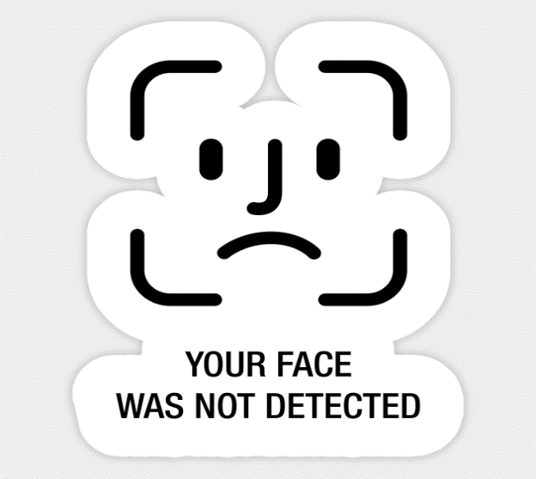
DISADVANTAGES
Low Reliability
Poor Image Quality
Storage of data can be Problematic
Facial Angles
Mis Identification
It cannot find the difference between identical twins.

Slide 16
APPLICATIONS
Marking Student Attendance at Universities, Colleges
MNC’S
Prisons
Military bases
Police Academic Training Centres
Airport Management

Slide 17
conclusion
In short, we can say that ,the system is totally built with the help of Python. The open source library (OpenCV) which is mainly process the real-time computer vision. NumPy which is for processing multidimensional array, that is used to process the image still faster.

Slide 18

A. Durga Prasad
K. Sanjay Kumar
K. Naveen
G. Nitish babu

